Slide 1
Combating e-Crime & the Importance of User Training
15-421/08-731 and 08-761/46-861 -- Fall 2013 – Lecture 7
Information Security & Privacy
Norman M. Sadeh
School of Computer Science
Carnegie Mellon University

Slide 2
Practical Info
Full Semester Students
Sept 24: Early Project Presentations (NSH1305)
5 minutes per team + Q&A
Content: What are the objectives, what is the approach, what is the timeline, who will do what
Mini Semester Students:
Homework Assignment #1 due by Sept 22
Midterm exam: Sept 24 – closed book- 219 Scaife Hall
Everything covered in class – at the level at which it was covered
Including high-level understanding of student presentations

Slide 3
Outline
Summary of previous lecture
E-Crime
Semantic attacks - Phishing
Cyber Security Training
Concluding Remarks

Slide 4
Changing Nature of Hacking
Early days: governments and scientists
1930’s Polish hackers crack Enigma code
1980’s: Teenagers hacking for fun
1990’s: Emergence of hacking for profit
2000’s: Organized crime takes over
Complex value chains emerge
Black market for zero-day exploits
Hacking becomes an industry
Rootkits, botnets and more
2010’s
Cybercrime intensifies
…and Governments engage in cyberwarfare
Advanced Persistent Threats (APT) (e.g. Aurora), Stuxnet, etc.
…Emergence of groups like Lulzsec

Slide 5
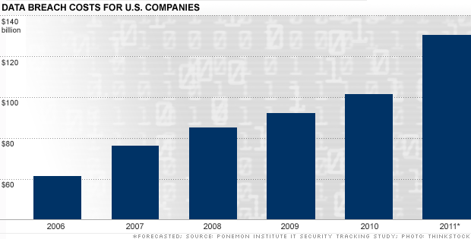
The Cost of Cyber Crime (US companies)
$130B in 2011 – 3 times as much as in 2006!
Source: Poneomon Institute
http://money.cnn.com/galleries/2011/technology/1107/gallery.cyber_security_costs/

Slide 6
Ponemon Institute – 2nd Annual Cost of Cybercrime Study (Aug 2011)
50 benchmark organizations (700 employees and above)
1.4 successful attack per organization per week!
Cyber attacks can get costly if not resolved quickly
Average time to resolve an attack: 18 days
Malicious insider attacks > 45 days
Early detection & remediation is key

Slide 7
All Sectors Suffer
Defense, utilities, energy and financial sector experience higher costs
Retail, hospitality and consumer products seem to experience lower costs

Slide 8
Mitigation
Run-of-the-mill security technologies:
Firewalls, filters, patching, multi-factor authentication, data leakage prevention, malware detection, intrusion detection, etc.
SIEM: Security Incident and Event Management tools – combines monitoring & analysis with incident response capability
GRC: Governance, risk management and compliance - incl. processes, access control (compliance with relevant regulations)
Employee Training

Slide 9
Highest Costs
External costs:
Information theft
Business disruption
Internal costs:
Detection and recovery

Slide 10
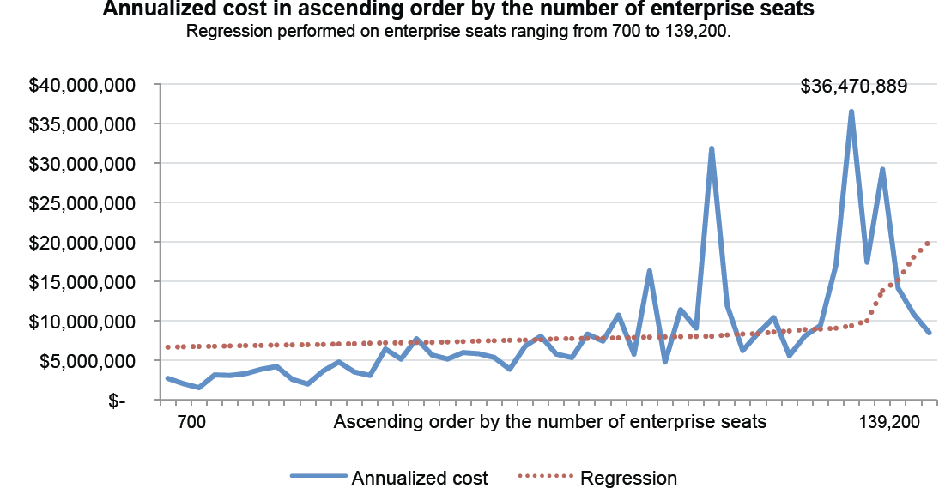
Cost of Incidents by Enterprise Size
Source: Poneomon Institute

Slide 11
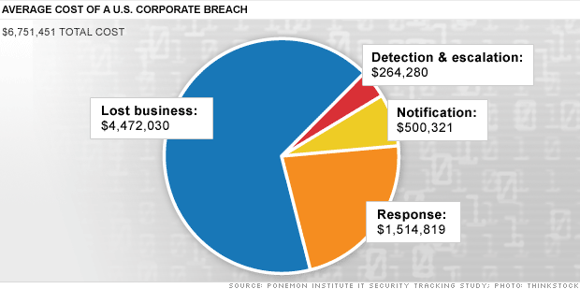
Average Cost of a Data Breach
Source: Ponemon Institute – July 2011
Example: database with customer details (e.g. email, credit card)
-on average companies lose 3.7% of their customers after an incident

Slide 12
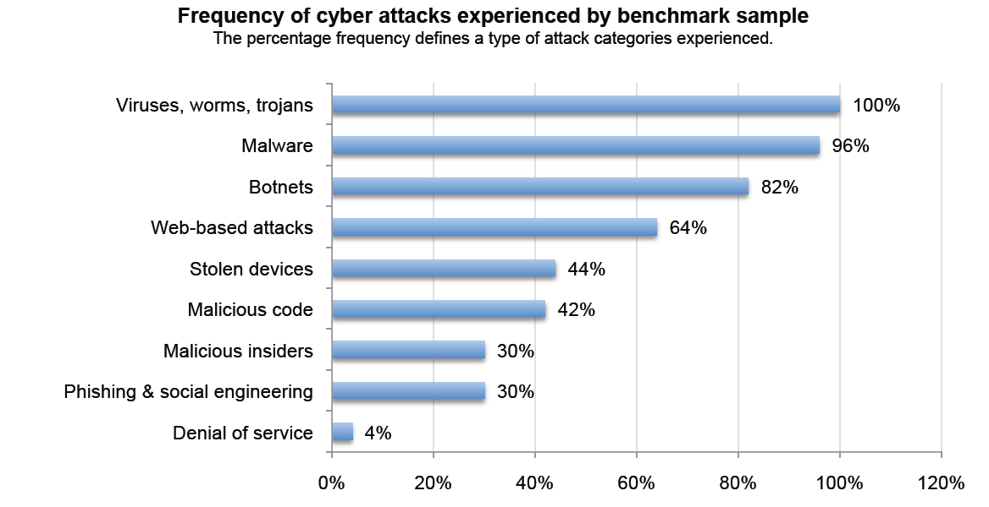
Frequency of Different “Attacks”
Source: Poneomon Institute

Slide 13
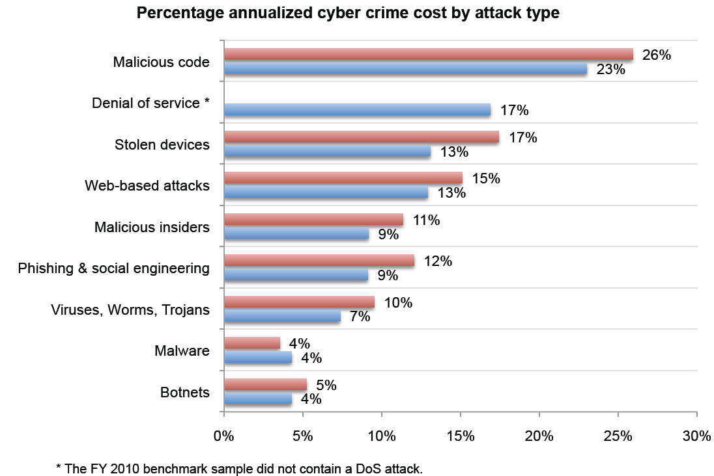
Cost Per Type of Attack
Source: Poneomon Institute

Slide 14
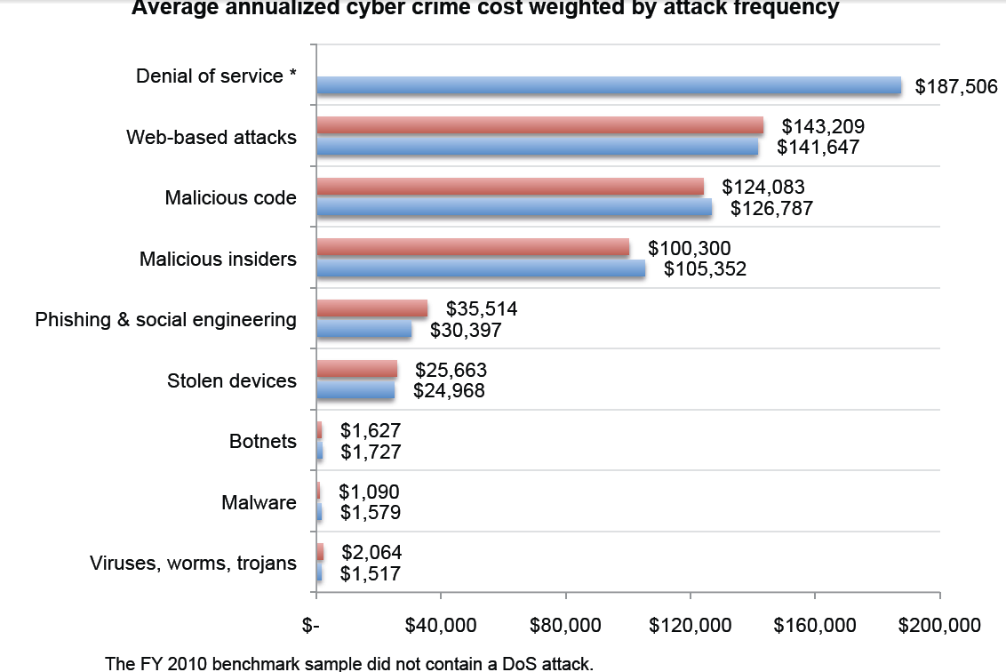
Cost Per Type of Attack – Weighted by Attack Frequency
Source: Poneomon Institute

Slide 15
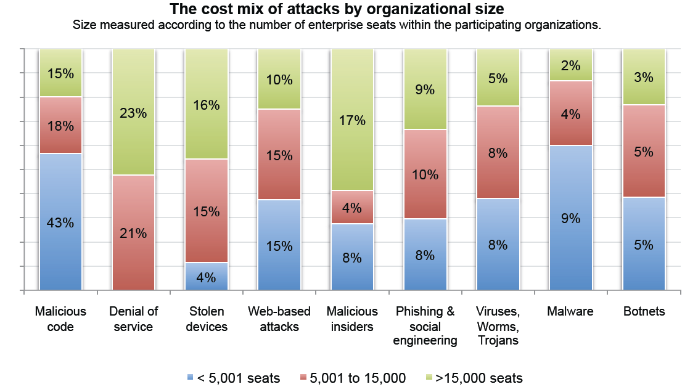
Different Mix of Attacks for Different Organization Sizes
Source: Poneomon Institute

Slide 16
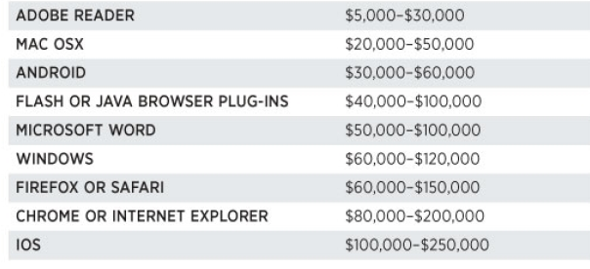
Price List of Zero Day Exploits
Source: Forbes, “Shopping for Zero-Day Exploits: A Price List for Hackers’ Secret Software Exploits” – 3/23/2012
Exploits are sold to governments and criminals
Hackers can also do the ethical thing, report the exploit to the software vendor and often collect a reward (albeit a smaller one)

Slide 17
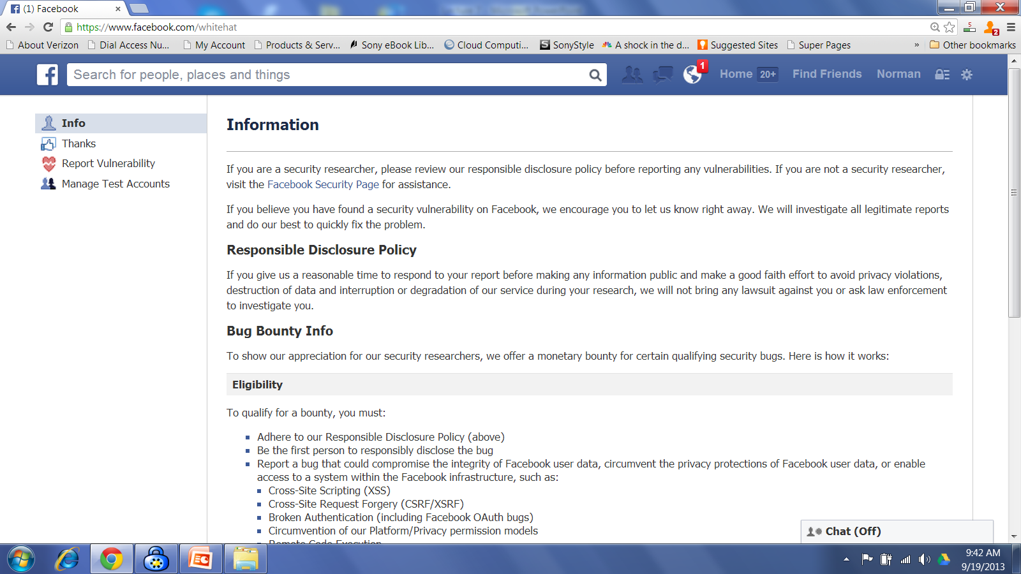
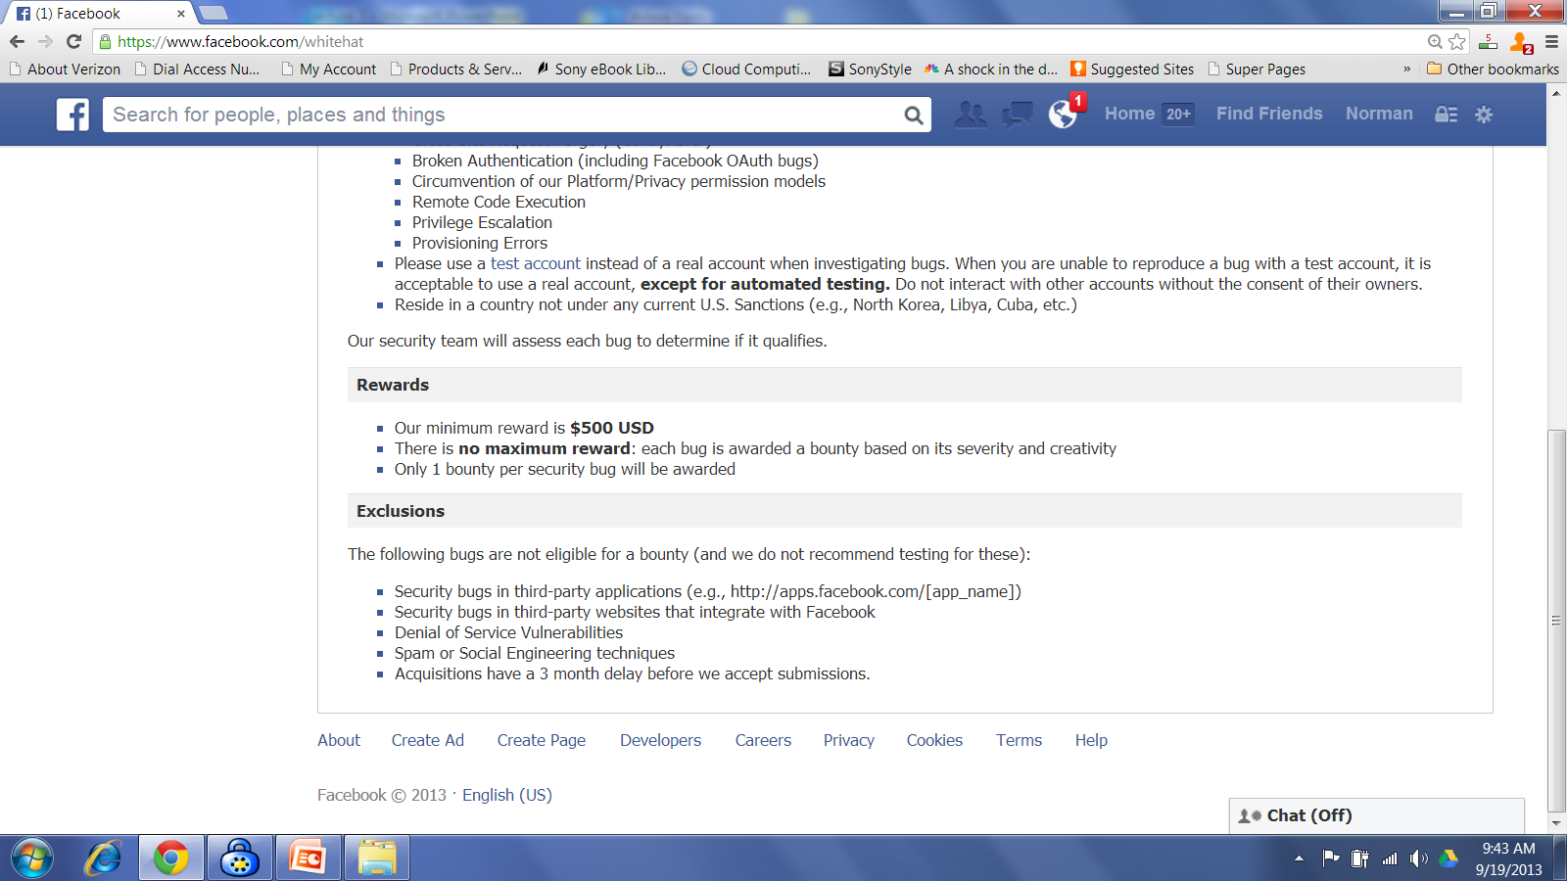
Example: Facebook

Slide 18
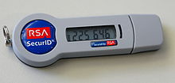
Attack on RSA Secure-ID (I)
March 2011 attack
Breach compromised master DB associating token IDs and secret token “seeds”
Eventually cost EMC around $66M
Start of the attack:
Spear-phishing email with excel attachment targeting an Adobe Flash zero-day exploit
Sent to a small group of RSA employees
Email title: “2011 Recruitment Plan”
Exploit allowed attackers to use Poison Ivy Remote Administration Trojan (RAT) to access RSA servers

Slide 19
Attack on RSA Secure ID (II)
Detection by RSA Netwitness but probably too late
Aftermath of the attack
Notifying all customers
Initially recommending they protect their token serial ID numbers!
SEC Form 8-K to notify shareholders
Originally claimed no financial impact expected!
June 2011: Lockheed Martin security breach attributed to the RSA Secure ID attack
June 2011: RSA offers free token replacement to all 30,000 corporate customers!

Slide 20
Looking More Closely at Phishing
What is Phishing?
How big of a problem is it?
What are the current solutions?
Carnegie Mellon University’s research on “Supporting Trust Decisions”
Largest US research projects on combating phishing attacks
Multi-pronged approach
Studies and existing deployments
Concluding Remarks

Slide 21
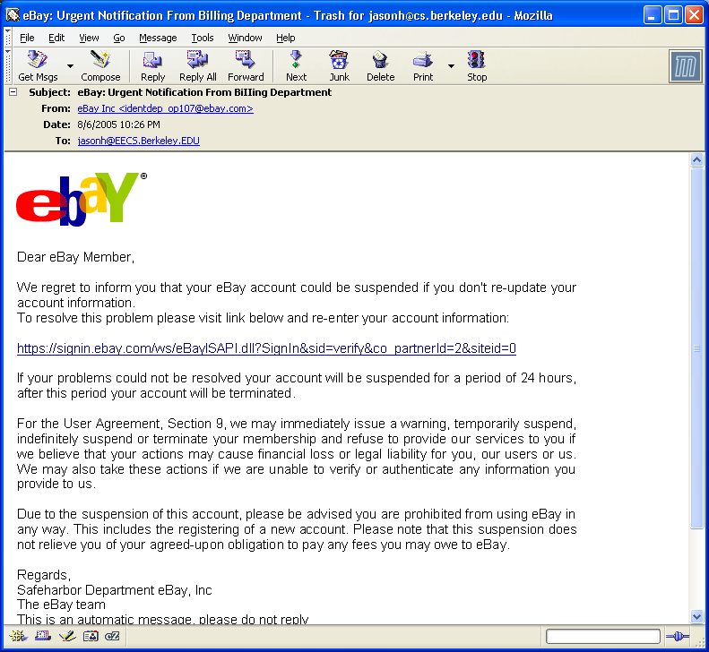
Everyday Privacy and Security Problem

Slide 22
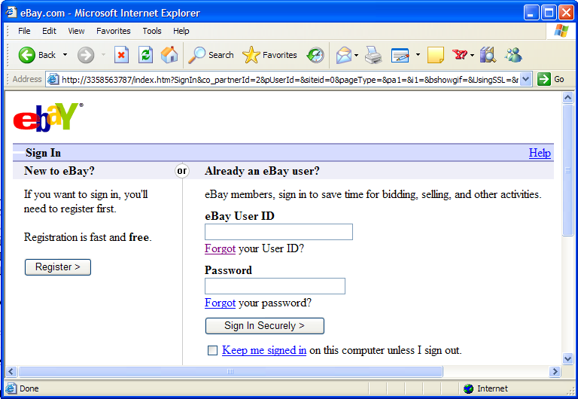
This entire process
known as phishing

Slide 23

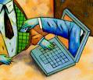
Phishing is a Plague on the Internet
~28000 unique phishing sites reported in Nov 2007
~$350m-$3b direct losses a year (sources: Google & Gartner)
Does not include damage to brand, loss of potential sales, etc.
…Just the tip of the
iceberg…
Notes:
2-3.5 million
http://www.gartner.com/it/page.jsp?id=498245
400 people per day
http://portal.acm.org/citation.cfm?id=1314391
Salesforce.com phish
http://blogs.zdnet.com/Berlind/?p=880
http://www.schneier.com/blog/archives/2007/11/targeted_phishi.html

Slide 24
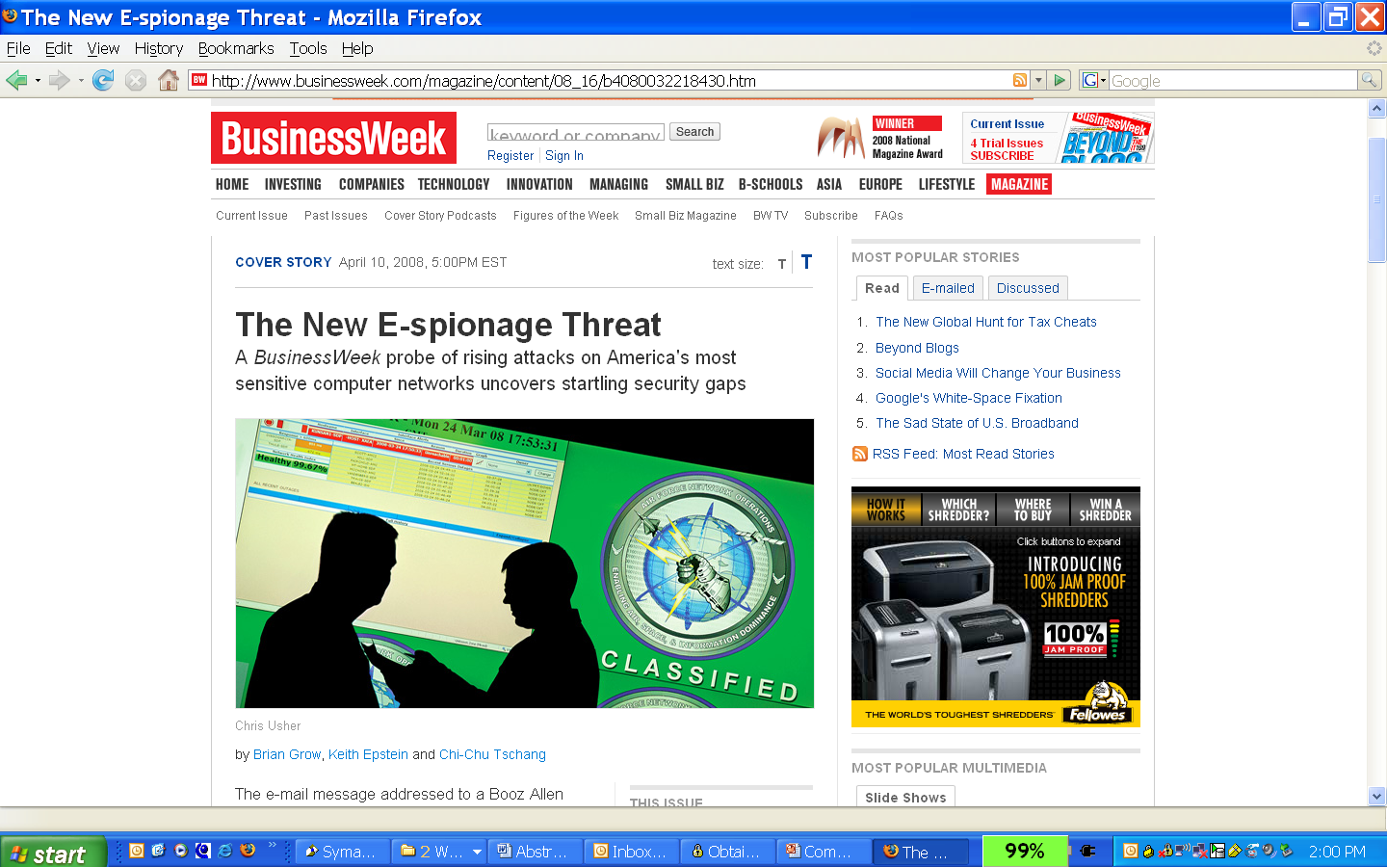
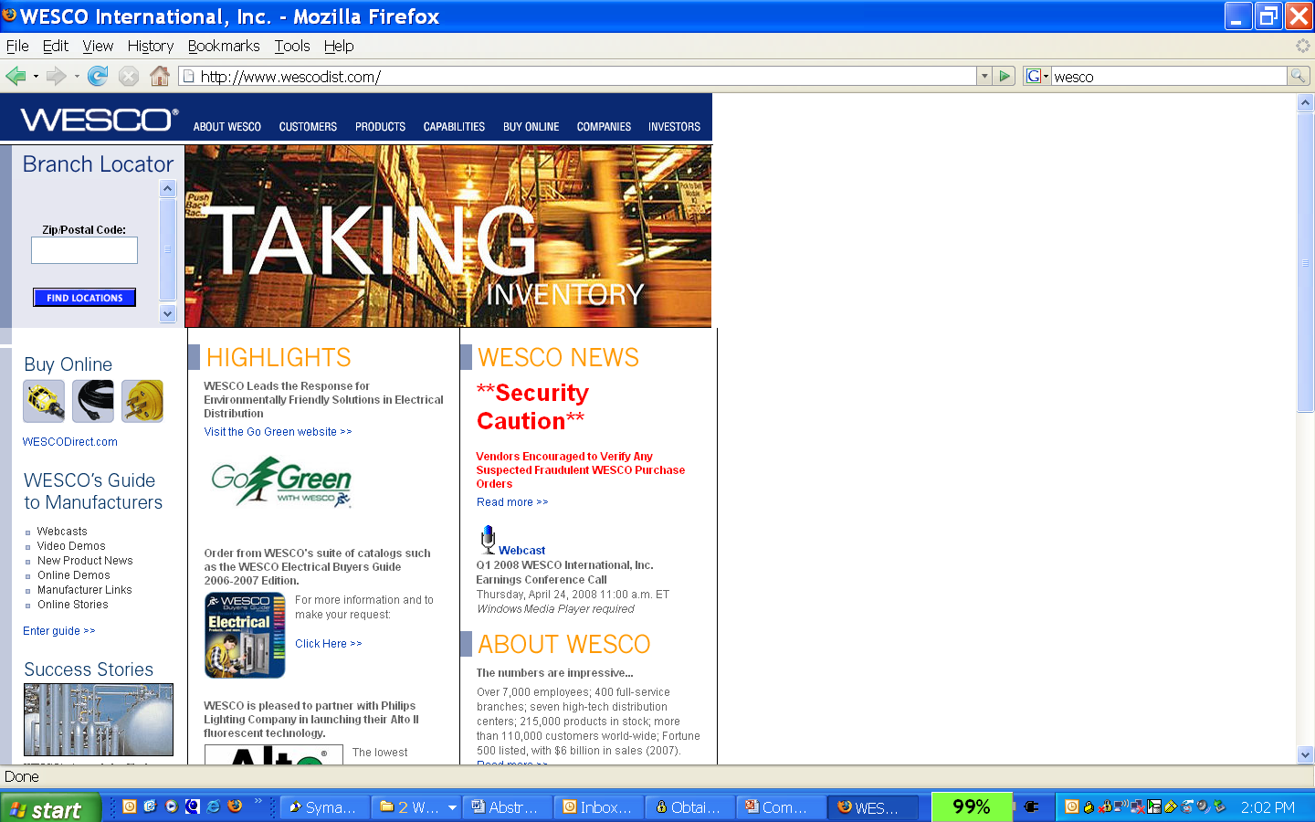
…Spear Phishing Attacks…
Major corporations and their vendors too!
The government and its contractors
are getting phished left and right

Slide 25
Spear Phishing
Phishing attacks also used for espionage
Government (e.g. IRS, Medicare/Medicaid, DoD)
Corporate, incl. pharmaceutical
Recent salesforce.com phish
Recent trend in targeting executives

Slide 26
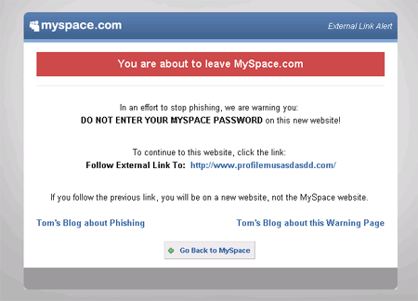
…and More…
SMiShing – SMS phishing
Example: “We're confirming you've signed up for our dating service. You will be charged $2/day unless you cancel your order."
When user clicks on the link, malware is installed
Vishing – VoIP phishing
Exploits caller ID spoofing
Instruct user to call a number and provide personal details
Social networks

Slide 27
Why do people fall for phishing attacks?

Slide 28
Interview Study – Back in 2005
Interviewed 40 Internet users, including 35 non-experts
“Mental models” interviews included email role play and open ended questions
Interviews recorded and coded
J. Downs, M. Holbrook, and L. Cranor.
Decision Strategies and Susceptibility to Phishing.
In Proc. of the 2006 Symposium On Usable Privacy and Security

Slide 29
Word of Caution
Today users have become more sophisticated about phishing attacks
…but the attacks have become more sophisticated too
…and the cost of phishing continues to go up…
This study is representative of the mismatch between people’s mental models and how technology actually works & the vulnerabilities it comes with

Slide 30
Little knowledge of phishing
Only about half knew meaning of the term “phishing”
“Something to do with the band Phish, I take it.”

Slide 31
Minimal knowledge of lock icon
85% of participants were aware of lock icon
Only 40% of those knew that it was supposed to be in the browser chrome
Only 35% had noticed https, and many of those did not know what it meant
“I think that it means secured.”
“It symbolizes some kind of security, somehow.”

Slide 32
Little attention paid to URLs
Only 55% of participants said they had ever noticed an unexpected or strange-looking URL
Most did not consider them to be suspicious
“If it wasn’t one of my standard dot-com, dot-edu, dot-us or some country code, then I would be really curious what that meant.”

Slide 33
Some knowledge of scams
55% of participants reported being cautious when email asks for sensitive financial info
But very few reported being suspicious of email asking for passwords
Knowledge of financial phish reduced likelihood of falling for these scams
But those knowledgeable about financial phish were not necessarily suspicious of other scams, such as amazon.com password phish

Slide 34
Naive evaluation strategies
The most frequent strategies don’t help much in identifying phish
This email appears to be for me
It’s normal to hear from companies you do business with
Reputable companies will send emails
“I will probably give them the information that they asked for. And I would assume that I had already given them that information at some point so I will feel comfortable giving it to them again.”

Slide 35
Past experience helps some
Those who had seen scams in the past could identify similar scams
All but one participant correctly identified a Katrina email message as a scam
But knowledge of some scams didn’t seem to help them identify other types of scams

Slide 36
Traditional Solutions
Fall Short

Slide 37
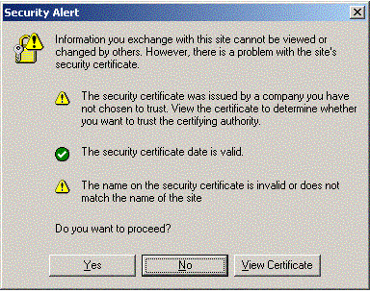
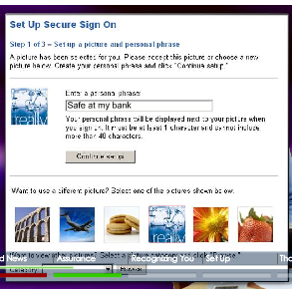
Today’s Solutions - in a Nutshell
Public Key Infrastructure or multi-factor authentication
People don’t understand certificates
Secure sign-on, using pictures and passphrases
Usability: people don’t notice/ignore

Slide 38
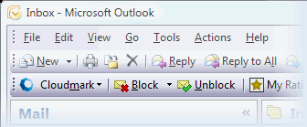
Today’s Solutions - in a Nutshell
Anti-phishing filters that rely on blacklists and whitelists
Always one step behind & possible liability

Slide 39
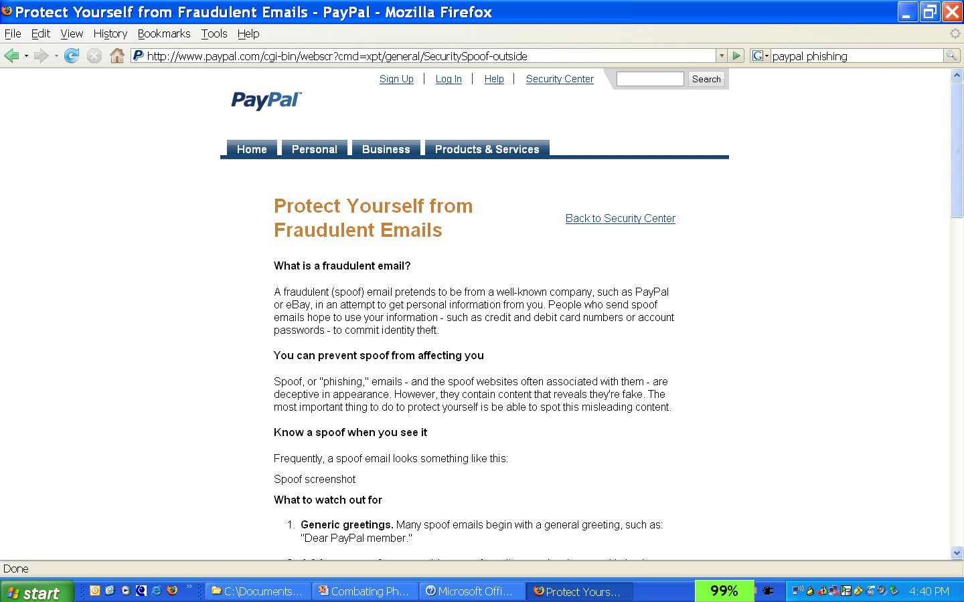
Today’s Solutions - in a Nutshell
Some training – e.g. websites, posters
Users just don’t pay attention

Slide 40

Today’s Solutions - in a Nutshell
Spam filters have limited success catching phish
In contrast to spam, phishing emails look legitimate

Slide 41
What else can we do?

Slide 42
Multi-Pronged Approach
Human side
Interviews to understand decision-making
Embedded training
Anti-phishing game
Computer side
Email anti-phishing filter
Automated testbed for anti-phishing toolbars
Anti-phishing toolbar
Automate where possible, support where necessary

Slide 43
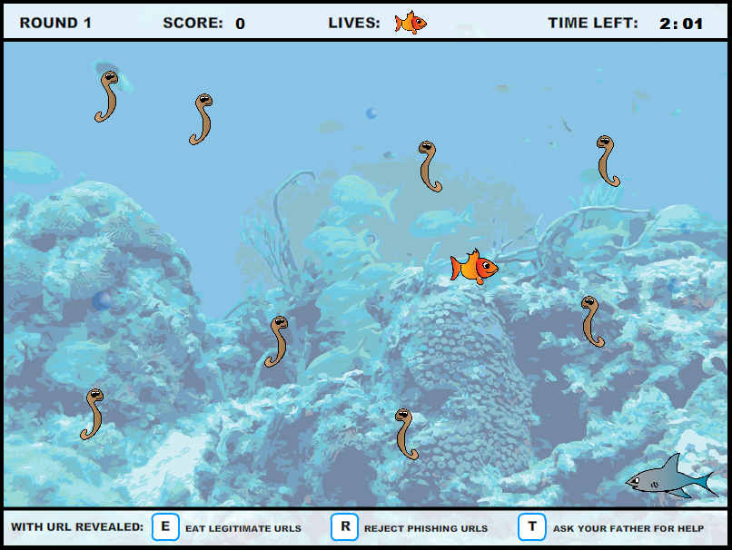
Anti-Phishing Phil Game
Rationale: Traditional training doesn’t work
But people do like playing games
Solution: A game teaching about phishing
Results with tens of thousands of users show:
People more willing to play game than read training
People better at identifying phishing sites after playing
S. Sheng, B. Magnien, P. Kumaraguru, A. Acquisti, L. Cranor, J. Hong, and E. Nunge. Anti-Phishing Phil: The Design and Evaluation of a Game That Teaches People Not to Fall for Phish. In Proc. of the 2007 Symposium On Usable Privacy and Security, 2007.

Slide 44
Notes:
The scene: is sea, we have a small fish called Phil, her job is to eat all the worms.

Slide 45
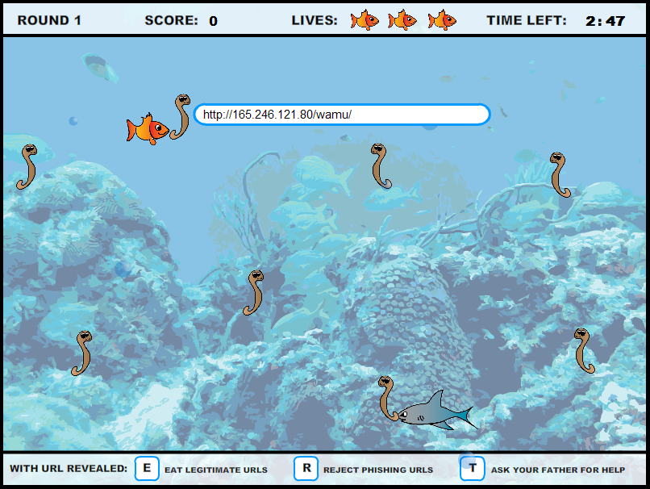
Notes:
So today, Phil swim by a worm, the worm is identified by a URL. A good worm is a legitimate URL, whereas a bad worm is a bait dropped by the phishers.

Slide 46
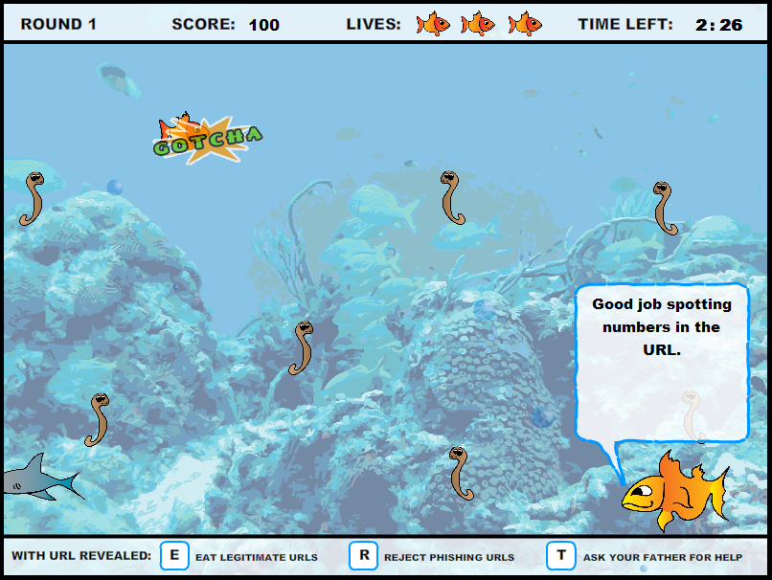

Slide 47
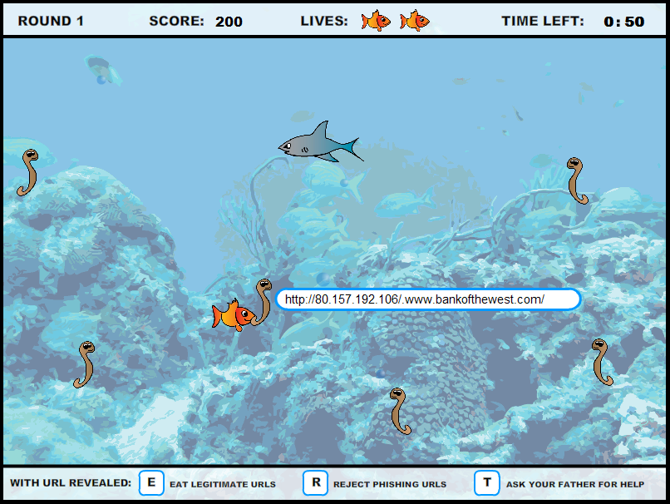

Slide 48
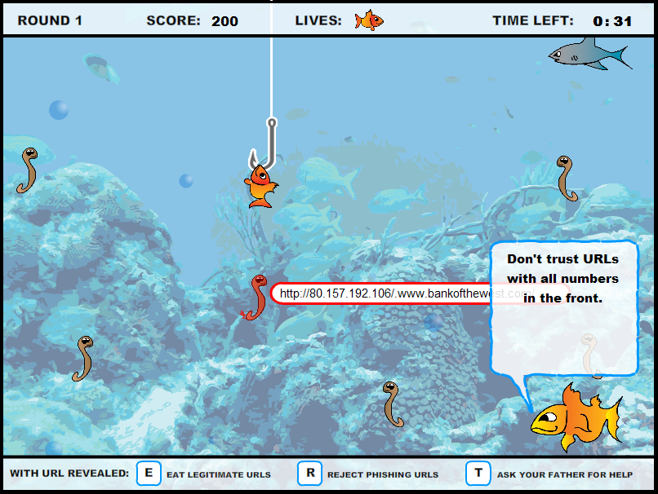

Slide 49
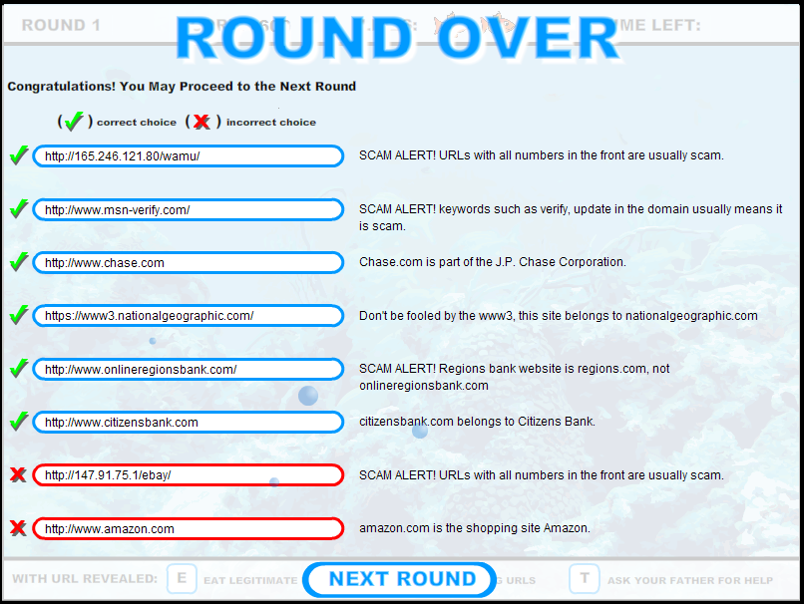
Notes:
Phil needs to score 6 / 8 to move on to the next rounds, and the end of the round, phil got a chance to reflect what he missed.

Slide 50
More about the game
Four rounds
Increasing difficulty
Two minutes in each round
Eight URL “worms” in each round
Four phishing and four legitimate URLs
Users must correctly identify 6 out of 8 URLs to advance

Slide 51
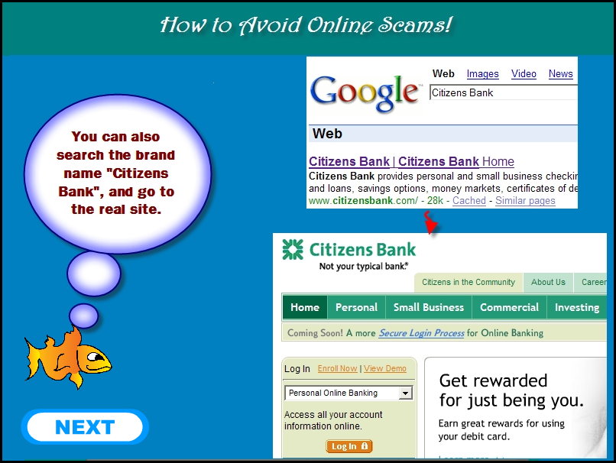
Notes:
In between rounds, we also have short tutorials to teach Phil better strategies to identify phishing. In this example, Phil’s father teaches Phil how to use a search engine.

Slide 52
User Study
Test participants’ ability to identify phishing web sites before and after training
10 URLs before training, 10 after, randomized
Up to 15 minutes of training
Three conditions:
Web-based phishing education
Tutorial
Game
14 participants in each condition
Screened out security experts
Younger, college students
Notes:
STUDY WAS A THINK ALOUD STUDY that lasts 45 - 60 MINS.. WE CAREFULLY RECRUITED NON-EXPERTS USING THREE SPECIFIC QUESTIONS - THE DEIFNITION OF NON EXPERT IS THE SAME AS IN PREVIOUS STUDY THAT I SAID.
It aimed at testing the participants’ ability to identify phishing websites. We presented them 10 websites before training, followed by a 15 minute break where users perform one of the three tasks: they read webased phishing education, they read the game tutorial, or they played the game. Users are randomly assigned in each of the conditions.
There are fourteen non-expert participants in each condition, for a total of 42 participants.

Slide 53
PhishGuru Embedded Training
Rationale: Existing training doesn’t work
Solution: Tool to train people during their normal use of email
Periodically, insert fake phishing emails in people’s regular mail
If person falls for it, intervention warns and trains user in succinct and engaging format
Provide reports to help companies assess their preparedness levels
Can be customized for individual orgs.
P. Kumaraguru, Y. Rhee, S. Sheng, S. Hasan, A. Acquisti, L. Cranor and J. Hong.
Getting Users to Pay Attention to Anti-Phishing Education: Evaluation of Retention and Transfer.
Proceedings of the 2nd Annual eCrime Researchers Summit, October 4-5, 2007

Slide 54
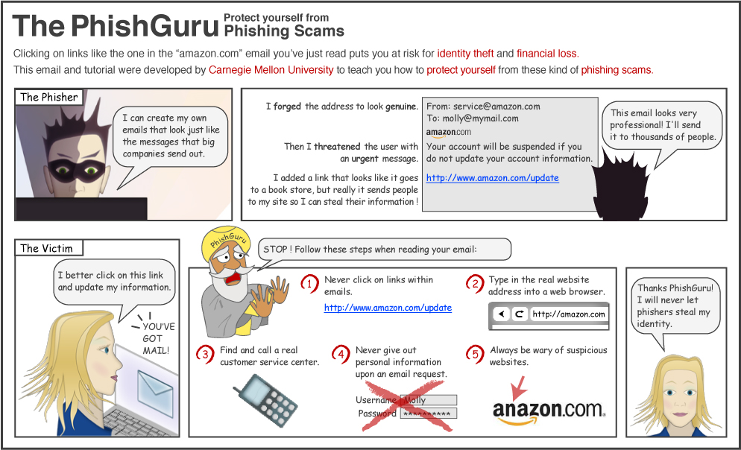
Comic Strip Intervention

Slide 55
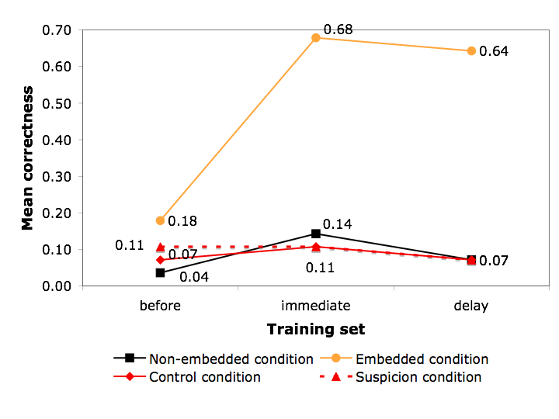
PhishGuru: Evaluation

Slide 56
Summary
eCrime takes many shapes and forms
Phishing is an example of semantic attacks
There are no silver bullets but rather combinations of solutions that can be used to mitigate risk
User education can play an important role but has traditionally been done very poorly

Slide 57
Acknowledgements
The work presented in this lecture is the result of a research collaboration with Jason Hong, Lorrie Cranor, Ponnurangam Kumaguru and other members of the CMU “Supporting Trust Decisions” project
Several of tools used to illustrate this lecture are now commercialized by Wombat Security Technologies

Slide 58
References
Required: These slides
http://www.freedomfromfearmagazine.org/index.php?option=com_content&view=article&id=305:cyber-crime-and-organized-crime&catid=50:issue-7&Itemid=187
http://www.hpenterprisesecurity.com/collateral/report/2011_Cost_of_Cyber_Crime_Study_August.pdf
Optional:
https://blogs.rsa.com/anatomy-of-an-attack/
Teaching Johnny Not to Fall for Phish P. Kumaraguru, S. Sheng, A. Acquisti, L. Cranor, and J. Hong. ACM Transactions on Internet Technology, Vol. V, No. N, September 2009, Pages 1–31.
School of Phish: A Real-Word Evaluation of Anti-Phishing Training. P. Kumaraguru, J. Cranshaw, A. Acquisti, L. Cranor, J. Hong, M.A. Blair, and T. Pham. SOUPS 2009. [Originally published as CyLab Technical Report CMU-CyLab-09-002, 2009]
Anti-Phishing Landing Page: Turning a 404 into a Teachable Moment for End Users P. Kumaraguru, L. Cranor, and L. Mather. CEAS 2009.
Learning to Detect Phishing Emails I. Fette, N. Sadeh, and A. Tomasic. In Proceedings of the 16th International Conference on World Wide Web, Banff, Alberta, Canada, May 8-12, 2007.
CANTINA: A content-based approach to detecting phishing web sites Y. Zhang, J. Hong, and L. Cranor. In Proceedings of the 16th International conference on World Wide Web, Banff, Alberta, Canada, May 8-12, 2007.

Slide 59
Q&A

